Slide 1


Brownlow Fold
Tapestry
Parent Guide

Slide 2
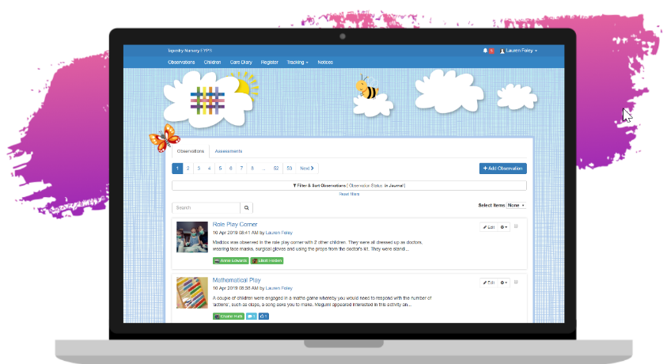
What is Tapestry?
Tapestry is on line learning journal for every child in Nursery and Reception.
Nursery and Reception teachers observe the children in their play, take photographs or videos and comment on what the child is learning.
Teachers link the observations to the Early Years Curriculum and the Characteristics of Effective Learning.
It can be accessed via the internet and through the website, or downloaded as an app.

Slide 3

How you can use it at home…
We would love for you to comment on your children’s learning journey, you will receive regular updates on your childs experiences in school.
It would be fantastic if you could add your own observations of your child when you notice them doing wonderful things at home.
Tapestry can be used on IPhone, Androids, IOS phones, laptops and computers.

Slide 4

Safe Usage
No information from Tapestry can be shared with other people, or published in any way.
Photographs or videos cannot be posted on social media or displayed in public places.
Misuse of Tapestry will result in withdrawal of your account.

Slide 5
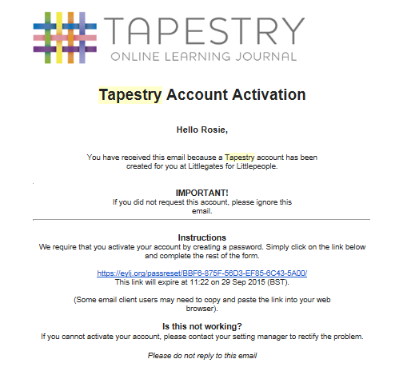
Tapestry – Account Activation
You will receive an email like this
Click on this link

Slide 6
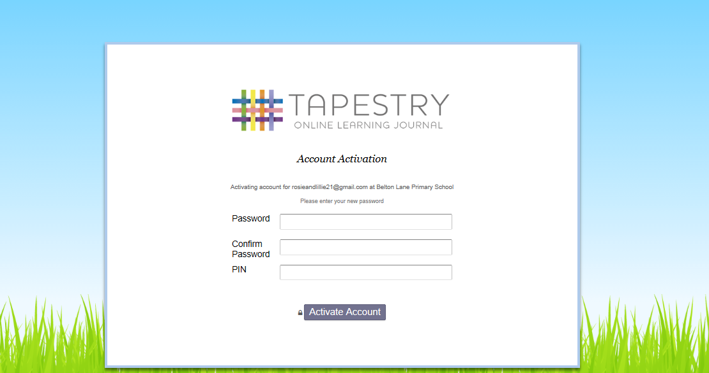
Tapestry – Password and Pin
Make your own password and pin code up, make sure you will remember it!

Slide 7
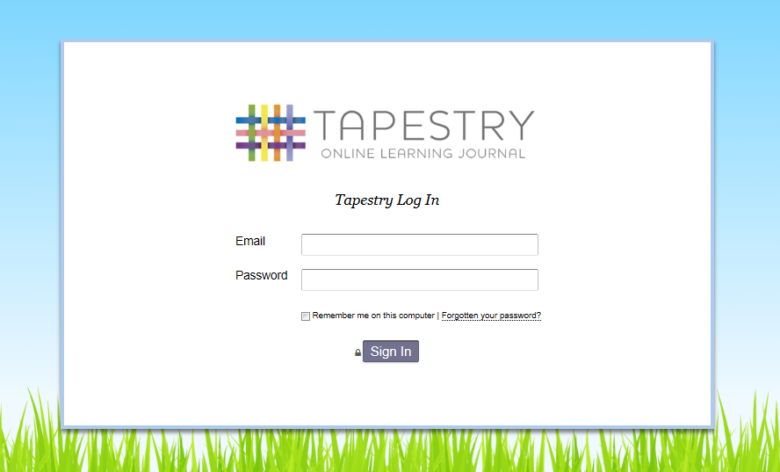
Tapestry – Account Activation
You will then see a message to tell you that your account has been activated followed by this screen:
Type in your email address and password and your child’s account will come up.
Pin codes can be used on handheld devices.

Slide 8
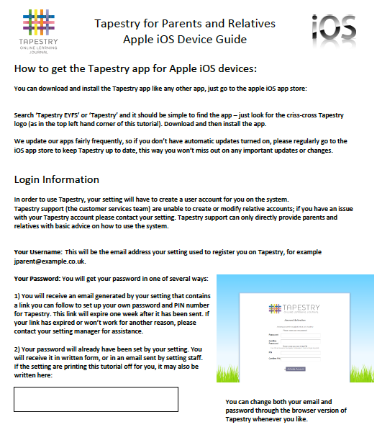
How do I add comments?
Every time you go onto an observation there is an option to add a comment on the bottom
(a lot like Facebook).
To add an observation simple click onto ‘add observation’. There are leaflets available here to support you if you are using an IOS phone, android or the Web - please help yourself.

Slide 9
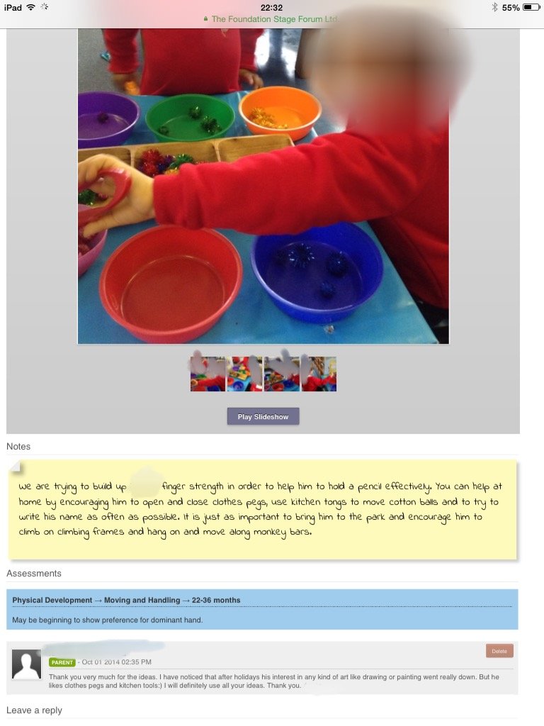
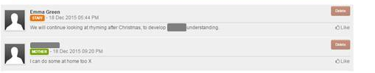
What should I comment on Tapestry?
Tell us if they have been doing anything similar at home or mentioned their learning.
Tell us how proud you are of their achievements.
Especially add comments if you are surprised they have achieved something you were unaware that they could do.

Slide 10
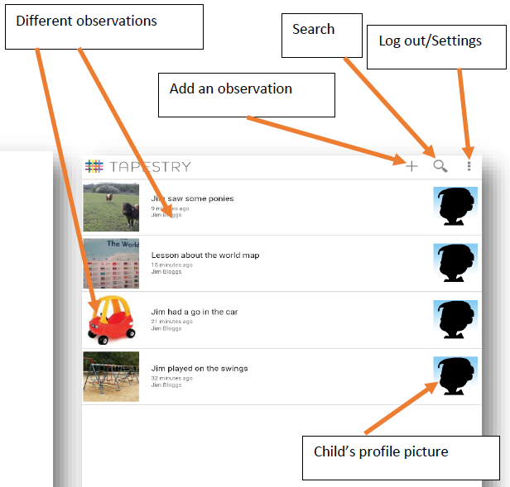
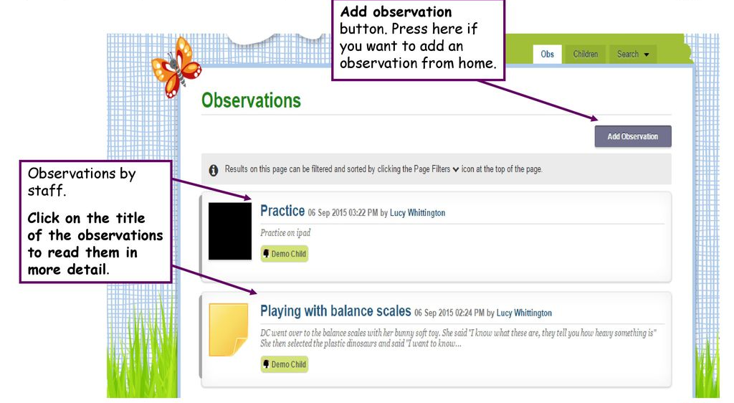
How do I add an observation from home?
Adding an observation can look different depending how you are accessing Tapestry.
(Website or app).

Slide 11
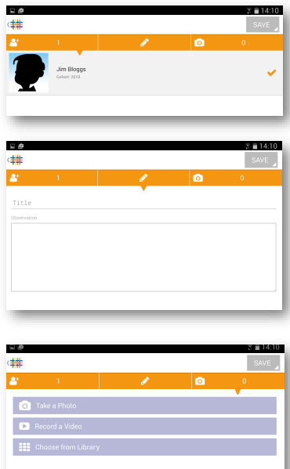
How do I add an observation from home?
First select the child you are adding an observation for.
(You will only be able to choose from the children who are linked to your account)
Press the pencil icon to write the notes for your observation.
Give your observation a title.
To add a photo or video press the camera icon, you can take a photo through the app.
If you have already taken a photo and it is saved in your photo library then choose to ‘choose from library’
When you have finished press SAVE
Your observation will now be saved in the child’s journal.

Slide 12
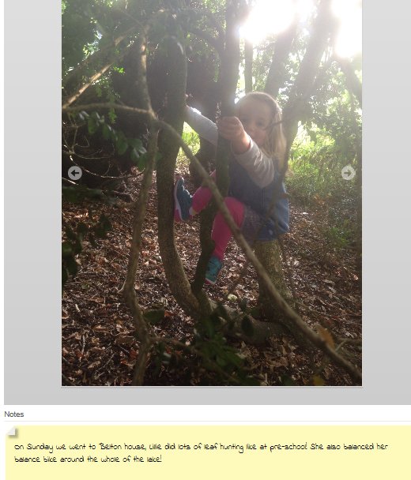
What should I observe?
Experiences that you have shared together, things you have noticed your child doing independently.
Achievements
Swimming
Gymnastics
writing
counting
colouring
Painting
And much, much more!

Slide 13
Brownlow Fold and Tapestry
Staff in Nursery and Reception have been using Tapestry since September 2019, we are happy to support some of your technical queries.
Things to be aware of…
You may not be able to view all your childs photos, sometimes if it is a group photo this can mean you will be unable to see it.
Observations may not be added daily
If you do not have access to the internet please speak with your childs teacher as they can support you with accessing their learning journal.

Slide 14


Slide 15

If you have any further questions please do not hesitate to contact myself or the staff in Nursery.
Main Message…
Make sure you’ve signed up
Comment on observations from school
Add your own observations
Talk to your child about what you have seen on tapestry

