Slide 1

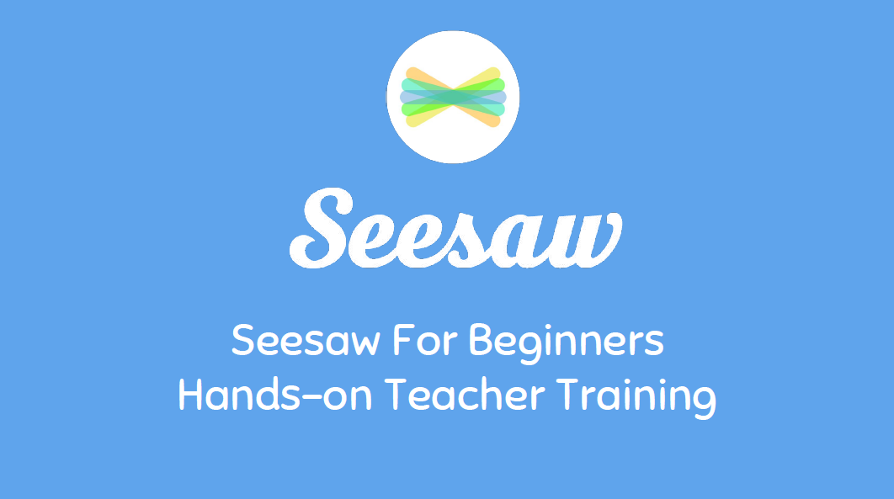
Brownlow Fold
Seesaw
Parent Guide

Slide 2
What is Seesaw?
Seesaw is is a platform for remote education during school or bubble closures.
Teachers can upload daily work and activities to empower the children to create, reflect, share, and collaborate.
Children can “show what they know” using photos, videos, drawings, text, PDFs, and links.
It allows us to gather children’s work in one place and share with families, and nothing is shared without teacher approval.
Teachers are able to provide feedback to individual children about their learning so far, as well as give next steps and personalised challenges.

Slide 3
How you can use it at home…
Seesaw is to be downloaded on your devices so you are ready to use it with your children in the event of a bubble or whole school closure.
Children will be expected to log on to Seesaw and work through the activities provided by their teacher each day that they are accessing remote learning.
Children need to record their work in their remote education purple book and upload this to Seesaw .
Your child’s teacher will be able to communicate with your child about their learning everyday.

Slide 4

Safe Usage
No information from Seesaw can be, or is to be shared with any other people, or published in any way.
Photographs or videos cannot be posted on social media or displayed in public places.
Misuse of Seesaw will result in withdrawal of your account.

Slide 5

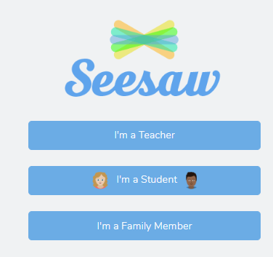
Seesaw – Account Activation
First log in either using the Seesaw Family app -
or through the Seesaw website
https://app.seesaw.me/#/login
Select ‘I’m a Student’ and add your log in details the class teacher has provided.

Slide 6
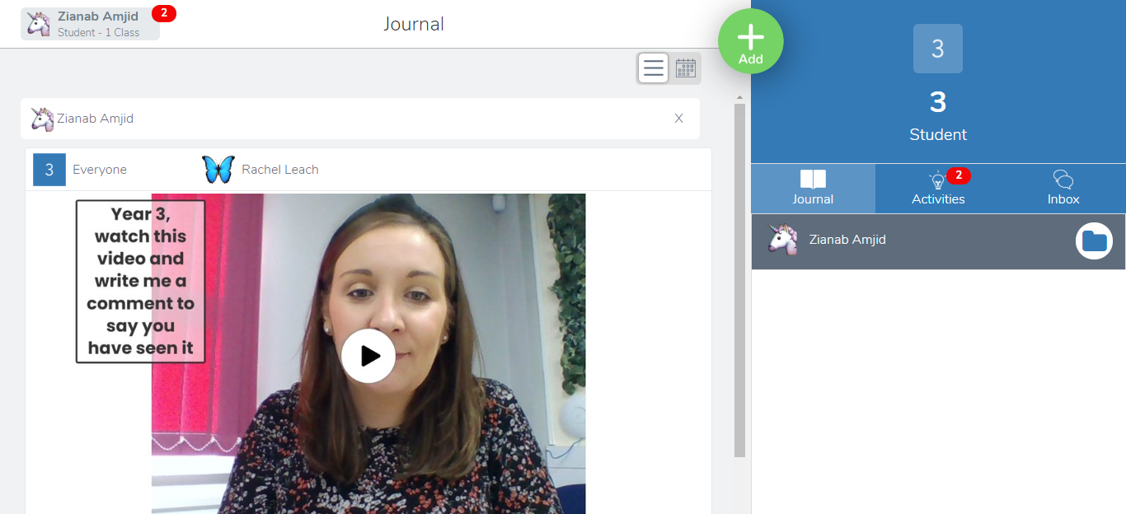
How do I use Seesaw?
Once logged in to Seesaw you will see your child's homepage -
Here you will be able to see any notifications from your teacher. The red ‘2’ indicates there are 2 new activities for your child to complete.
Your child's class will be displayed here
Your child's name will be here
The inbox is where children and families are able to message the class teacher privately about your child’s learning.
You can use the green ‘add’ button to share work, photographs or videos with your teacher.
Here is your child’s journal where all videos, notes and photographs from the class teacher will be stored.

Slide 7
Features of Seesaw
Journal – A record of your child’s submitted work which can be viewed and accessed on the Journal tab. Children are able to add Photos, Videos, Notes, Links and Upload documents and files from their devices.
Inbox - Class teachers can add messages to the Class Announcements section. These may be text, photos or videos. Keep keep checking in for new messages on a regular basis.
Activities - Class teachers will post activities and learning for your child to complete to the Activities section of Seesaw. To view the activities, click ‘Activities’ on the navigation tab. Activities will be displayed on the left hand side of the screen. To view the activity, simply click on the chosen activity on the left hand side of the screen. A small pop up box will show a thumbnail of the activity alongside instructions for what to do.

Slide 8
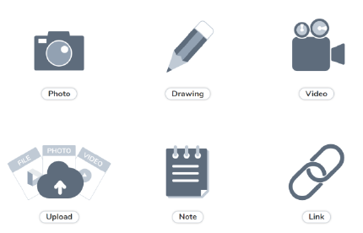
Completing Activities on Seesaw
You will then see this screen –
We are asking all children to complete tasks set using their Remote Education exercise book. Copies of the work can then be uploaded to your child’s Journal by selecting either the Photo icon or Upload icon shown above.

Slide 9
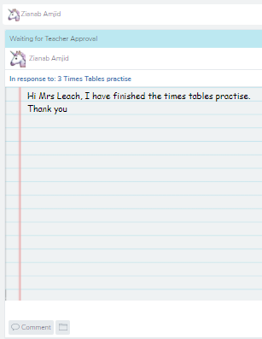
What should I comment on Seesaw?
This child has left the teacher a note after completing the maths activity.
The child can also comment at the bottom right hand side of the page to talk about their learning further with the teacher.
The teacher will be able to reply and give next steps or an additional challenge for the child to complete.

Slide 10
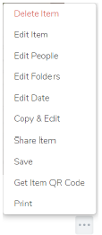
Completing Activities on Seesaw
Work uploaded to the journal can be edited, printed and deleted by clicking on the three dots under the work image and selecting the appropriate item.
Signing-Out - You can sign out of your child’s Seesaw account by clicking the named icon at the top left of the screen and selecting Sign out.

Slide 11

If you have any further questions please do not hesitate to contact your child’s class teacher.
Main Message…
Make sure you have downloaded the app and logged in.
In the event of individual pupil self isolation, a school or bubble closure ensure your child logs in and uses Seesaw everyday.
Add your remote learning work for the teacher to see.
Comment and respond to your teacher throughout the day.
Seesaw will be used, just like we are still in the classroom with our friends and teachers. It is imperative that every child in the class joins in and completes the work on a daily basis.

